Slide 1

Dr. NTR UNIVERSITY OF HEALTH SCIENCES VIJAYAWADA, ANDHRA PRADESH MDS PRACTICAL EXAMINATION –SEPTEMBER 2020
GOVERNMENT DENTAL COLLEGE AND HOSPITAL
DEPARTMENT OF PERIODONTICS AND IMPLANTOLOGY
HT .NO: 18D315011003

Slide 2
MAJOR CASE PRESENTATION

Slide 3
Demographic data
Name: kavitha
Age: 40 yrs
Sex: Female
OPD no.: Jan 11.5
Occupation: Teacher
Address: Proddatur

Slide 4
Chief complaint: Patient complaints of loosening of lower front teeth since 2 months and bad breath since 1 month
History of present illness : Patient complaints of loosening of lower front teeth since 2 months without any pain. Patient has discomfort due to mobility. Patient has bad breath since 1 month. Patient noticed bad breath after waking up in the morning.

Slide 5
Past dental history: History of oral prophylaxis 1 year back.
Medical history : No Relevant Medical History
Family history: No Relevant Family History

Slide 6
Oral hygiene habits:
Type OF BRUSH: Soft
Direction: Horizontal scrubbing
Duration: 3 minutes
Dentifrice: Non medicated
Frequency: Once daily in the morning

Slide 7
General examination: Conscious, coherent, cooperative and well oriented.
Extraoral examination:
Symmetry: Apparently symmetrical
Lymph nodes: Not palpable
TMJ: No Abnormality Detected
Lip seal: Potentially competent

Slide 8
INTRAORAL EXAMINATION
Labial mucosa: No Abnormality Detected
Buccal mucosa: No Abnormality Detected
Tongue: No Abnormality Detected
Palate: No Abnormality Detected
Floor of the mouth: No Abnormality Detected

Slide 9
Halitosis: Present
Local causes: Plaque and calculus
ORAL HYGIENE STATUS:
OHI-S=D.I-S+C.I-S
2.1+2.1=4.2 POOR ORAL HYGIENE
16 | 11 | 26
3 | 1 | 2
3 | 2 | 2
46 | 41 | 36
16 | 11 | 26
3 | 1 | 2
2 | 3 | 2
46 | 41 | 36

Slide 10
Periodontal index:(Russell A.L 1956) P.I SCORE PER PERSON= SUM OF INDIVIDUAL SCORE/NO.OF TEETH PRESENT=172/31=5.54 (TERMINAL DISEASE)
2 | 6 | 6 | 6 | 6 | 6 | 6 | 6 | 6 | 6 | 6 | 6 | 6 | 6 | 6 | 2
8 | 7 | 6 | 5 | 4 | 3 | 2 | 1 | 1 | 2 | 3 | 4 | 5 | 6 | 7 | 8
2 | 6 | 6 | 6 | 6 | 6 | 6 | 8 | M | 6 | 6 | 6 | 6 | 6 | 6 | 2

Slide 11
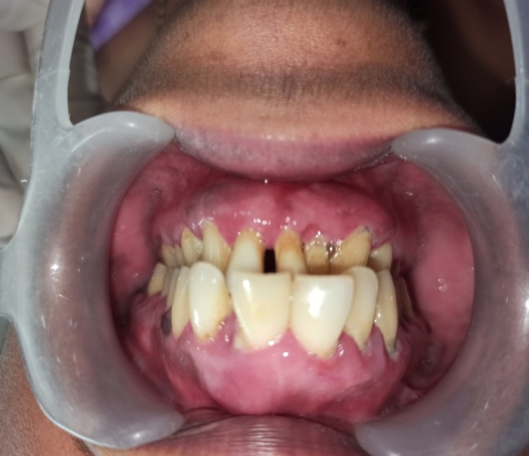
GINGIVAL STATUS
Color: Generalized erythematous reddish pink gingiva with marked melanin pigmentation irt distal of 23

Slide 12
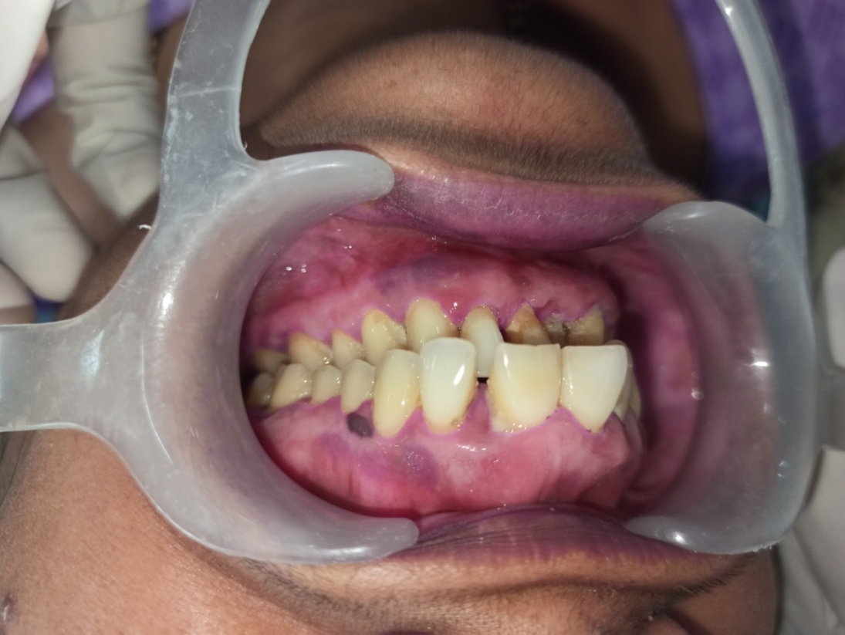
Consistency: Generalized soft and edematous
Contour: Generalized irregular contour with rounded edges.
Size: Generalized diffuse enlargement is seen.

Slide 13
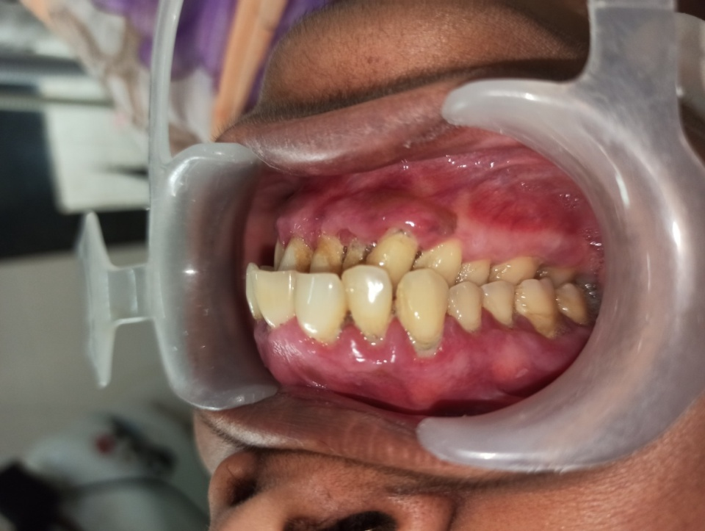
Surface texture: Generalized loss of stippling
Position: Coronal displacement of papillary gingiva irt 12,13,23,32,33,42,43

Slide 14
Bleeding on probing: Generalized
Exudation: Generalized purulent exudate present.

Slide 15
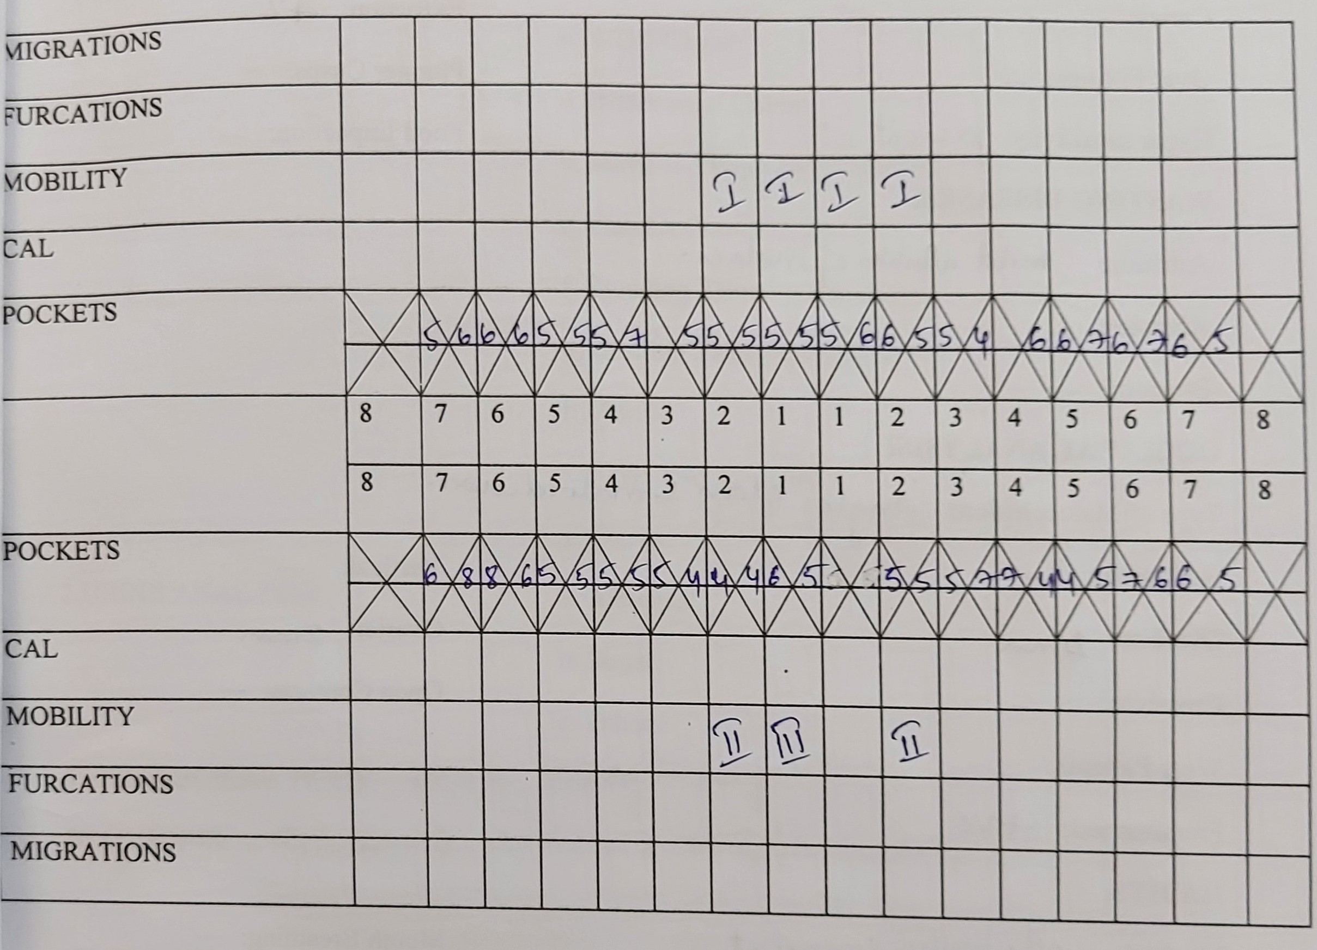
PERIODONTAL STATUS

Slide 16
Mobility:
Grade I irt 11,12,21,22,.
Grade II irt 42,32
Grade III irt 41

Slide 17
Width of attached gingiva: Adequate
Depth of vestibule: Adequate
Frenal attachment:
Maxillary: Mucosal
Mandibular: Mucosal
Tension test: Negative

Slide 18
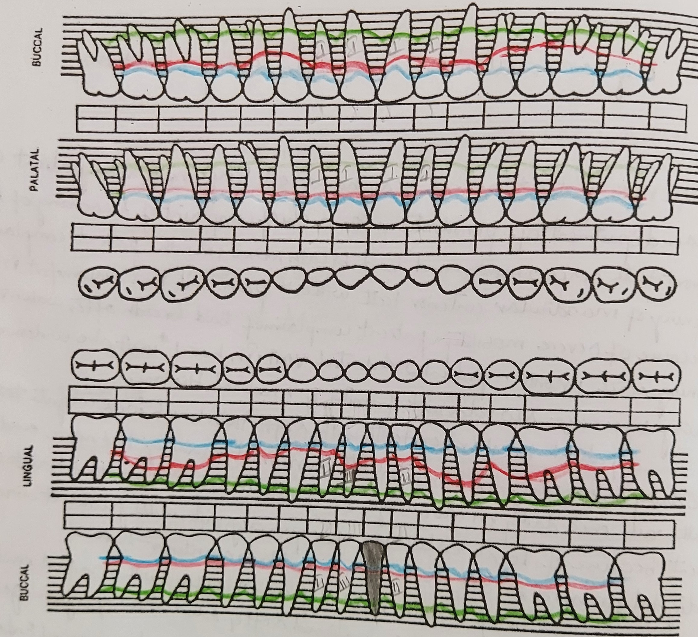
PRESURGICAL CHARTING

Slide 19
Dental status:
Number of teeth: 31
Missing teeth: 31
Hypersensitivity: Present
Extrusion: 42

Slide 20
FREMITUS TEST- POSITIVe- CLASS-1

Slide 21
Occlusal analysis:
Type: Angles class 1 malocclusion
Overbite: 4 mm
Overjet: 3 mm

Slide 22
Provisional diagnosis: Generalized Periodontitis stage III, grade B.

Slide 23
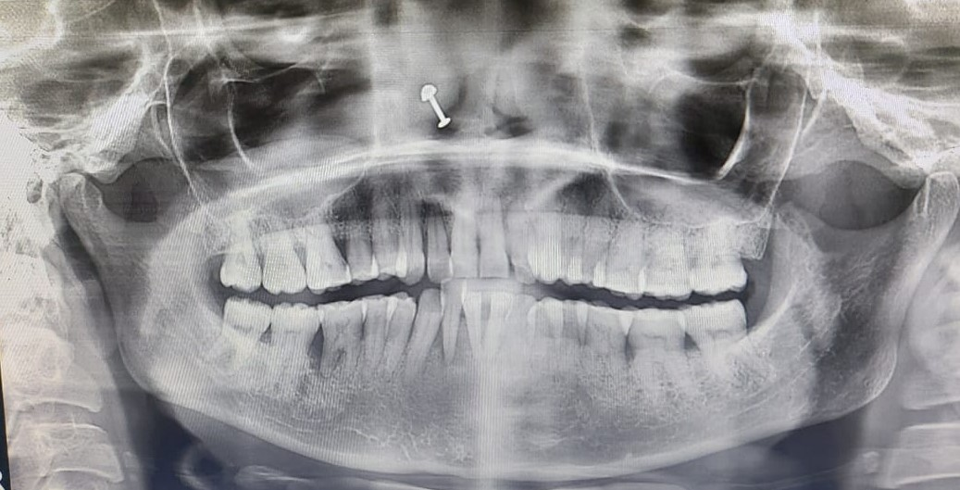
OPG

Slide 24
Final diagnosis:
Generalized Periodontitis stage III grade B.
Prognosis:
Overall: Fair
Individual: Good- 13,14,15,17,23,24
Fair-23,24,25,26,27,34,35,36,37,16
Poor- 32,42,11,12,21,22,46
Hopeless-41

Slide 25
TREATMENT PLAN
Emergency Phase: Advised Extraction irt 41
Phase I: Patient education and motivation
Oral hygiene instructions
Scaling and root planing
Splinting irt 32, 33, 42, and 11,12,21,22
Phase IV: Recall and maintenance for 1-2 months

Slide 26
Phase II:
Flap surgery with regenerative procedure.
Phase IV: Recall and maintenance for every 1-2 months

Slide 27
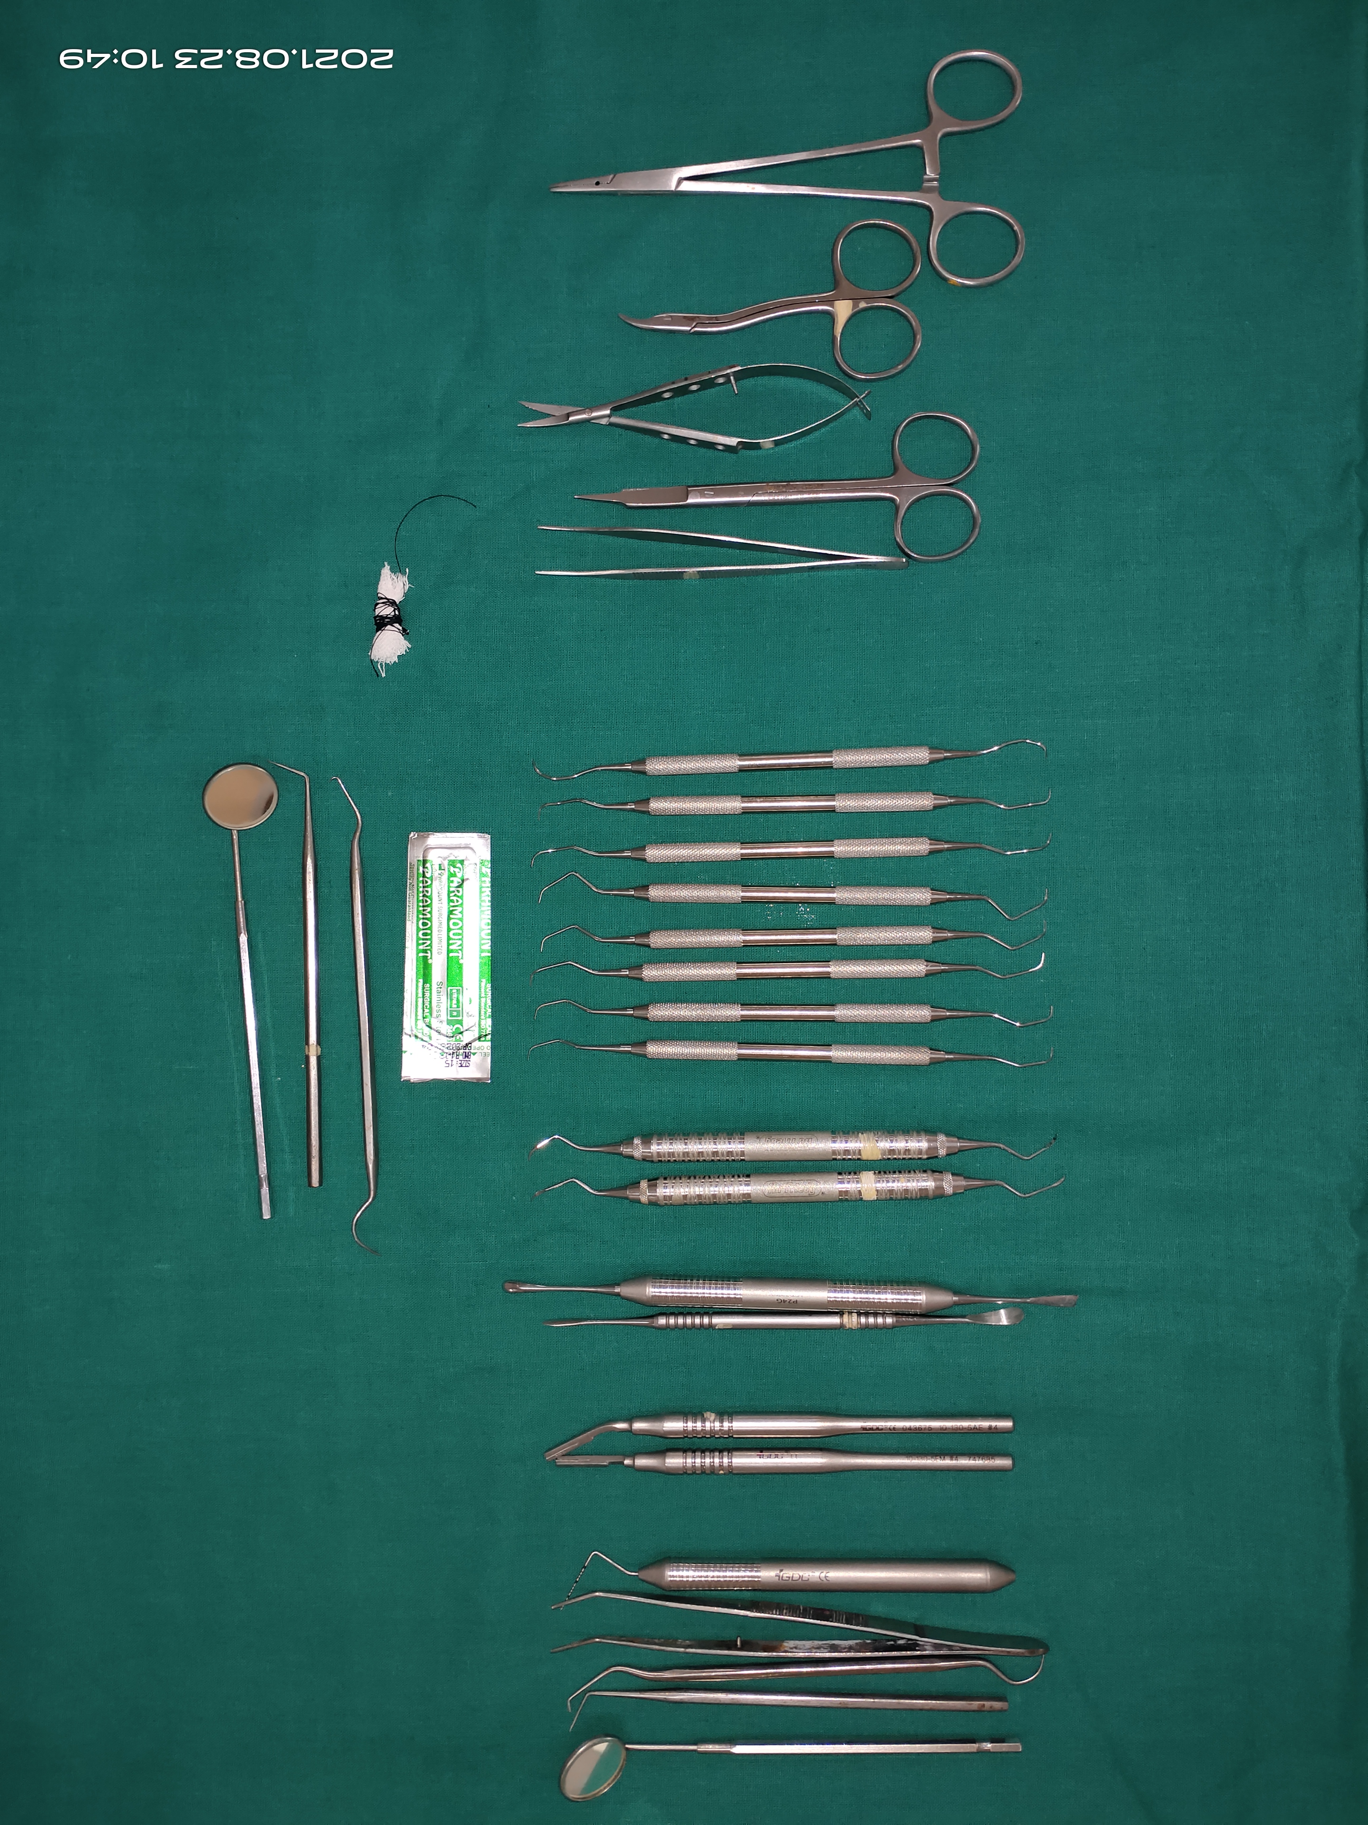
ARMAMENTARIUM

Slide 28
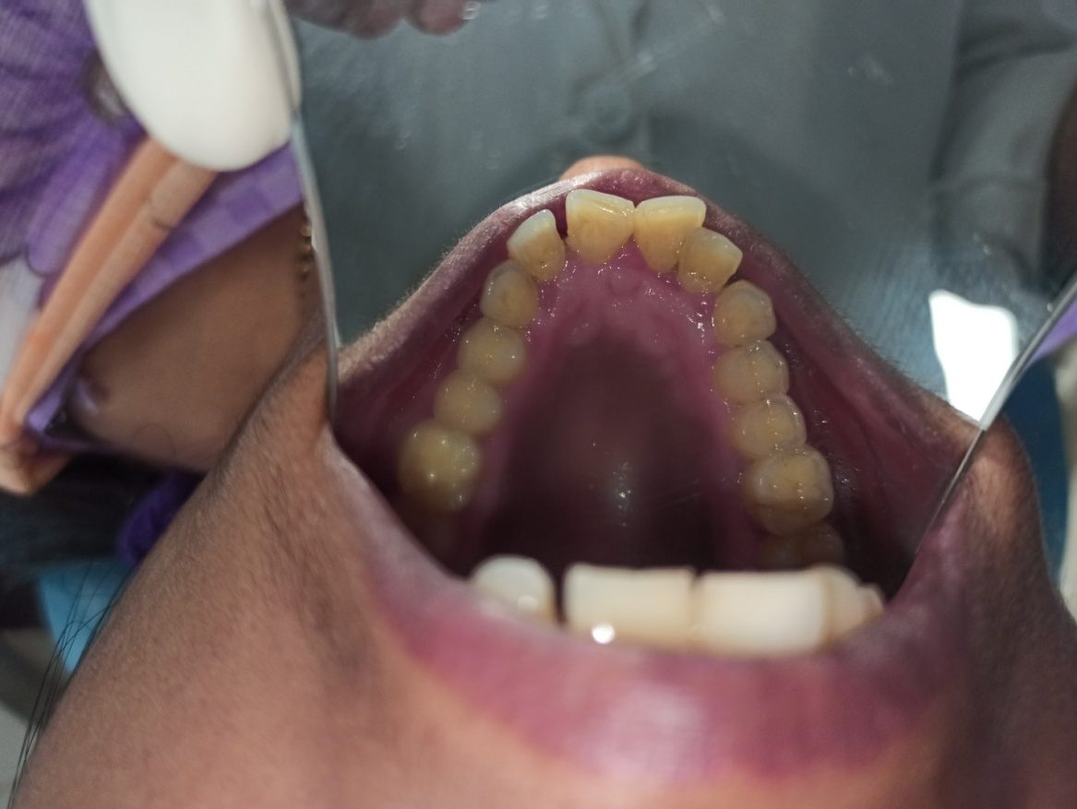
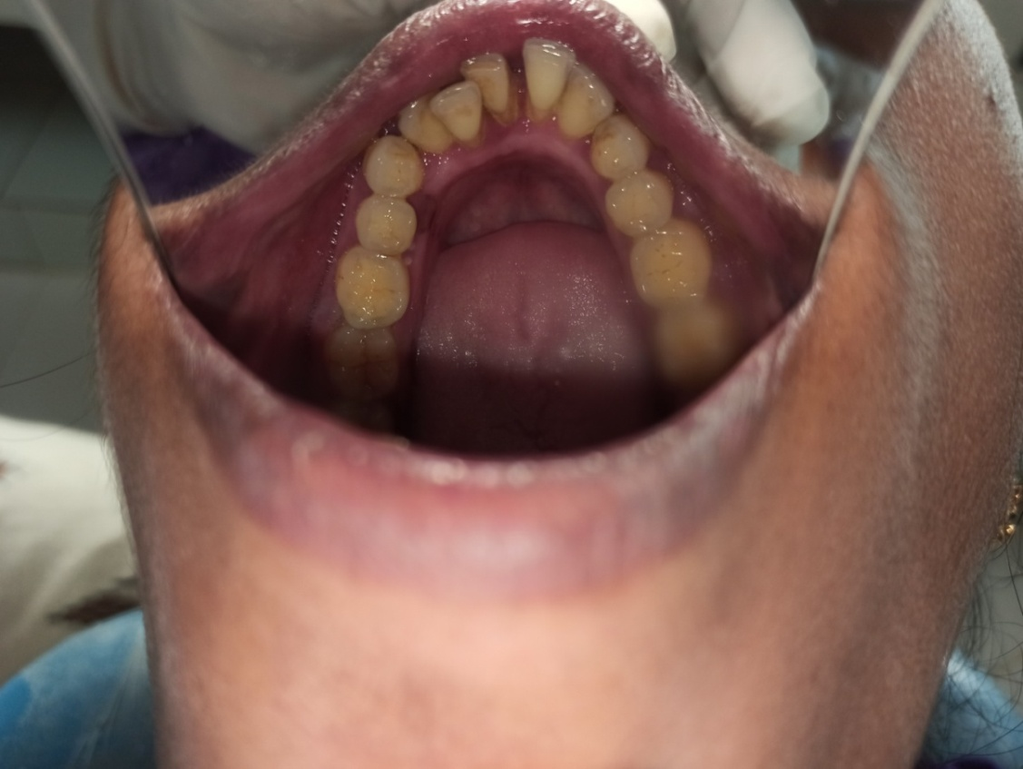
PRE OPERATIVE

Slide 29
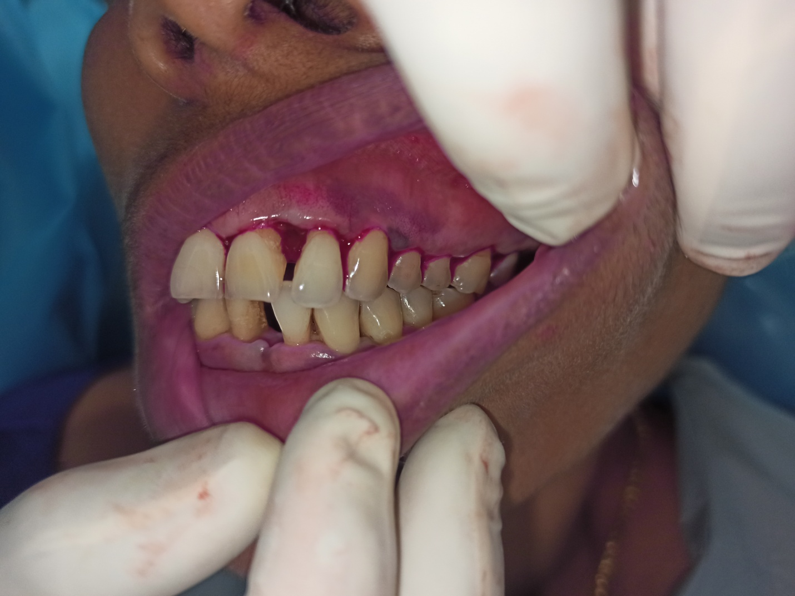
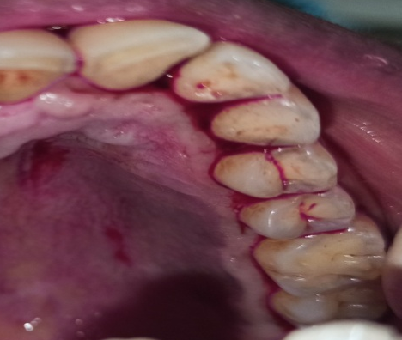
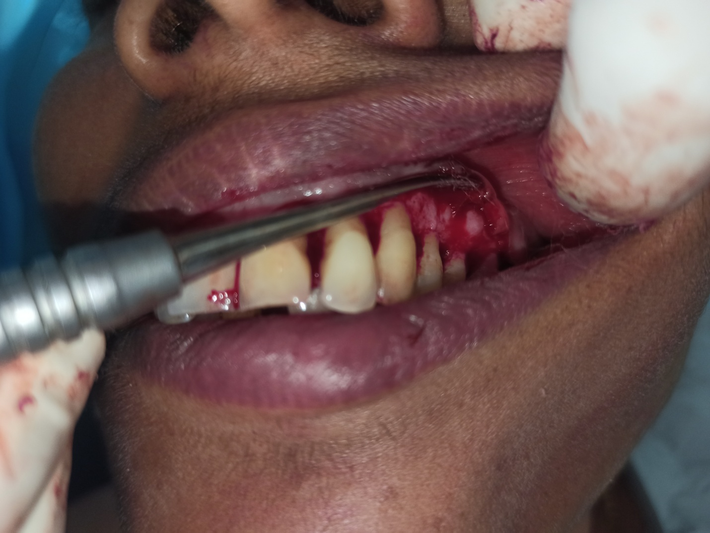
1ST QUADRANT
INCISIONS
REFLECTION

Slide 30
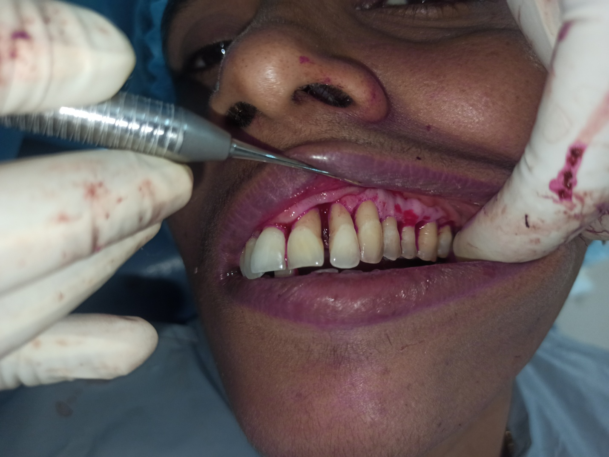
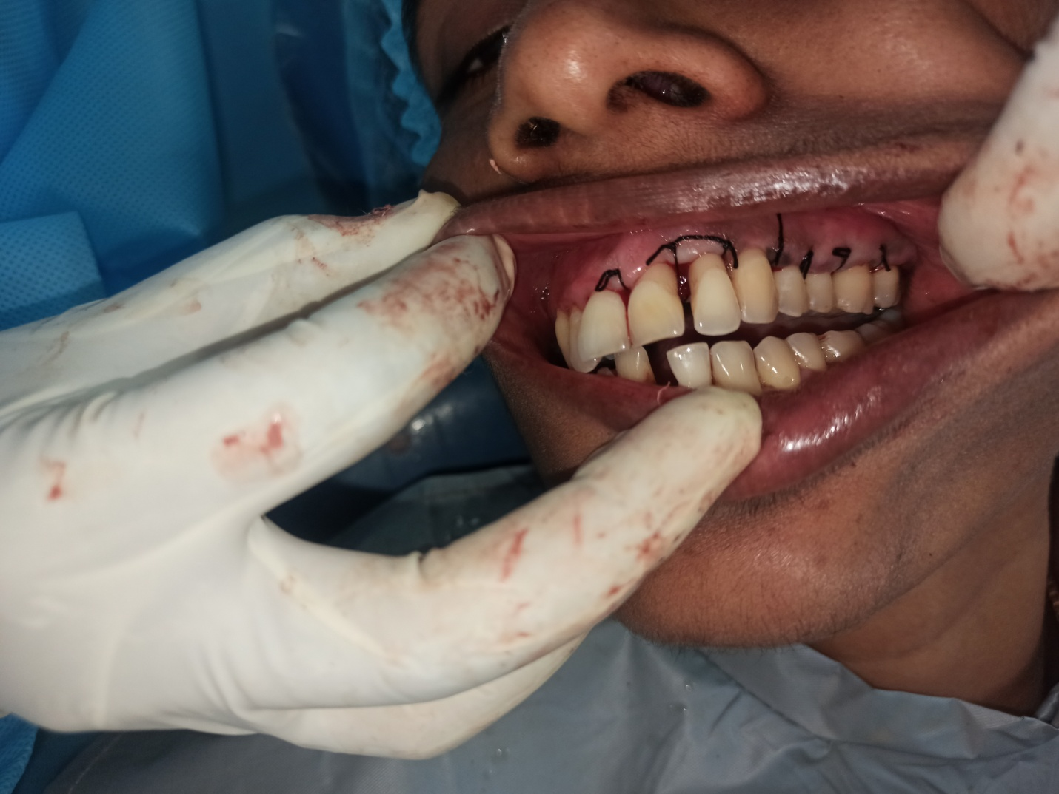
DEBRIDEMENT
SUTURING

Slide 31
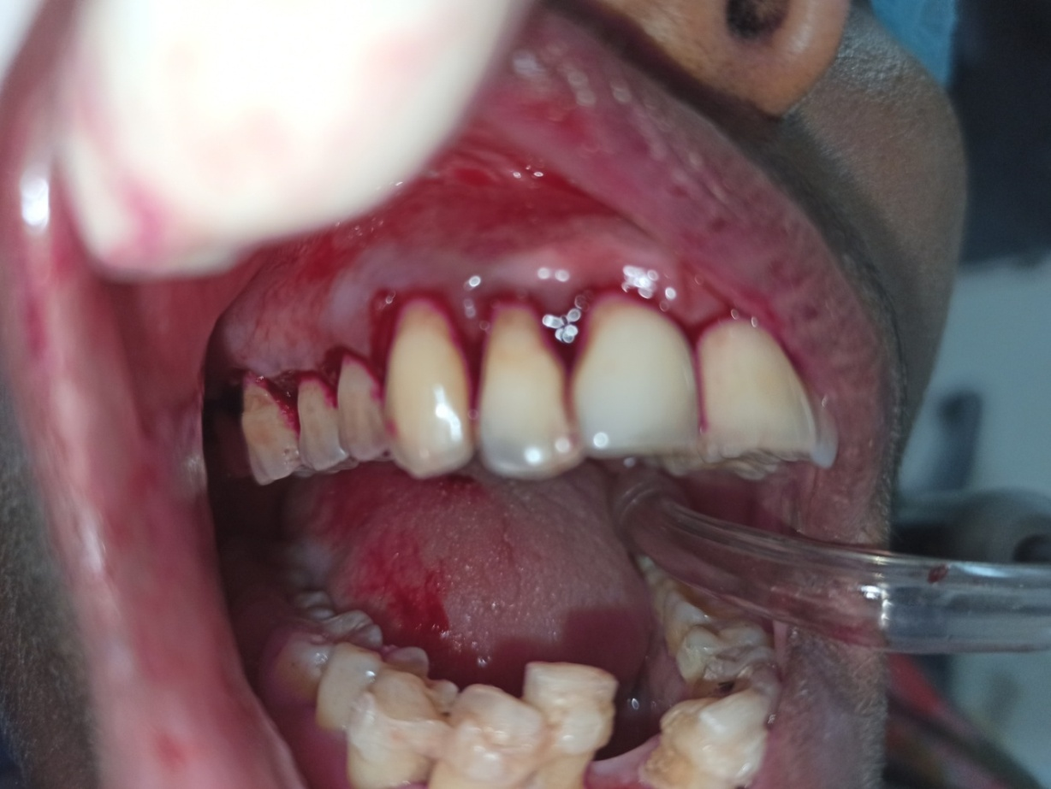
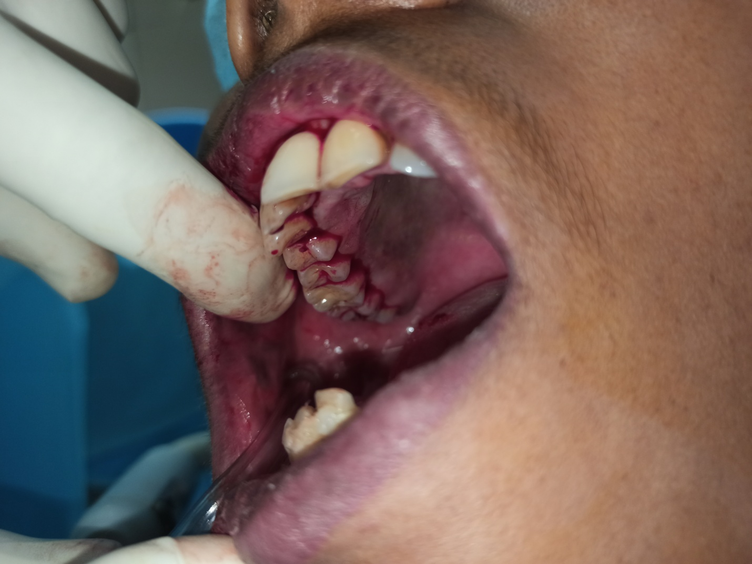
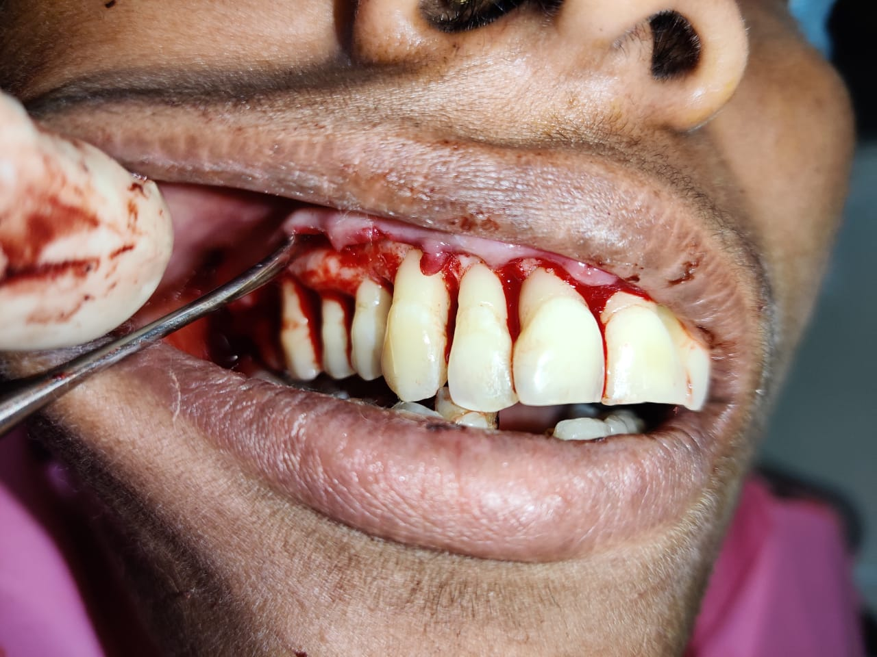
2ND QUADRANT

Slide 32
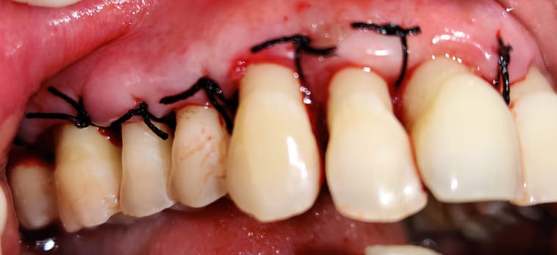
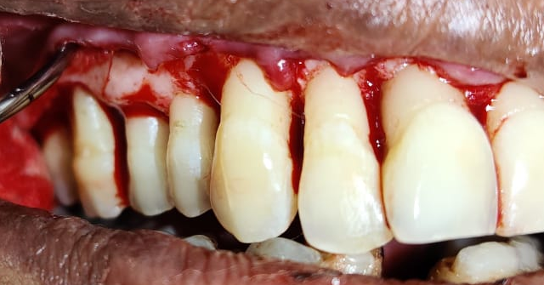

Slide 33
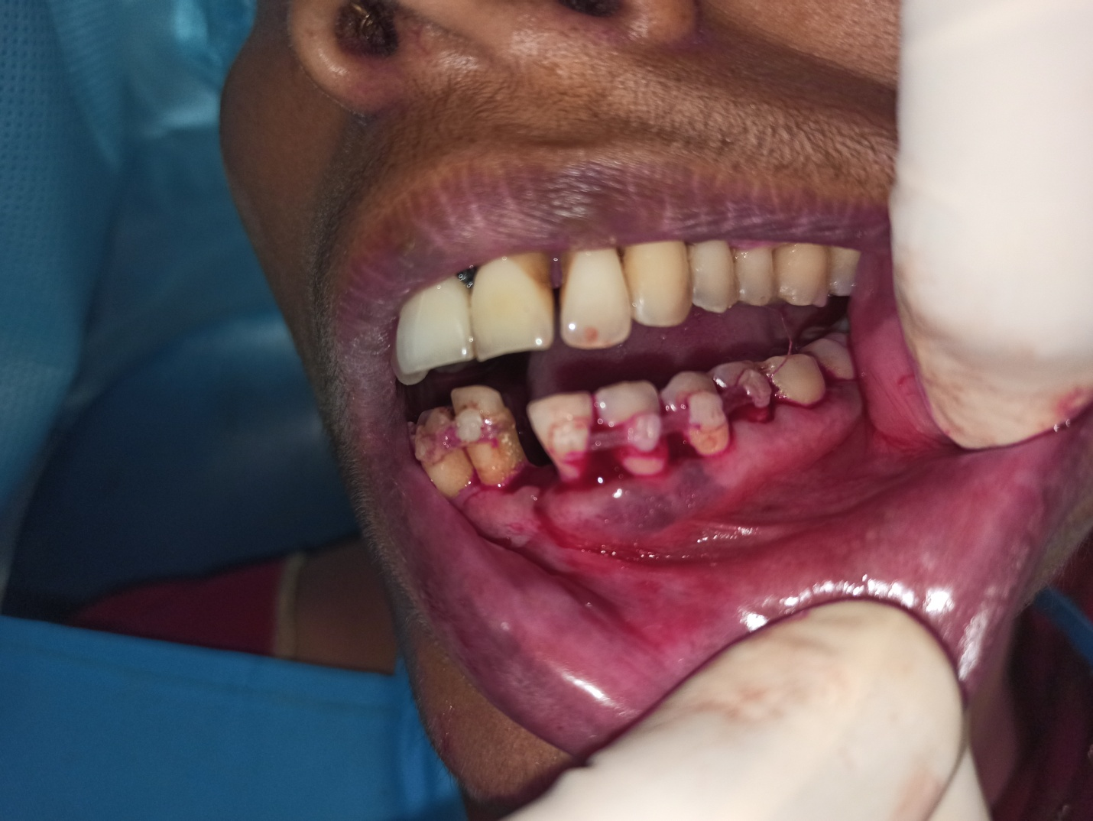
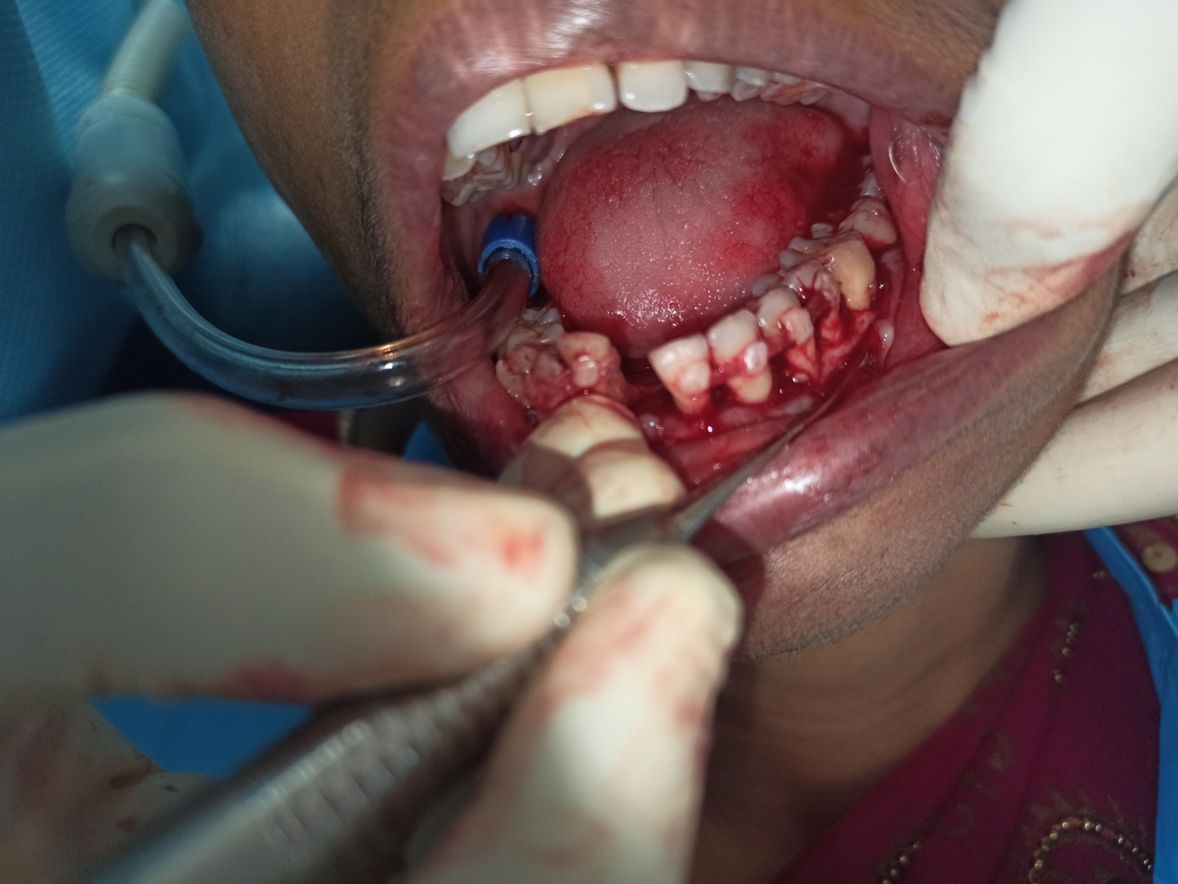
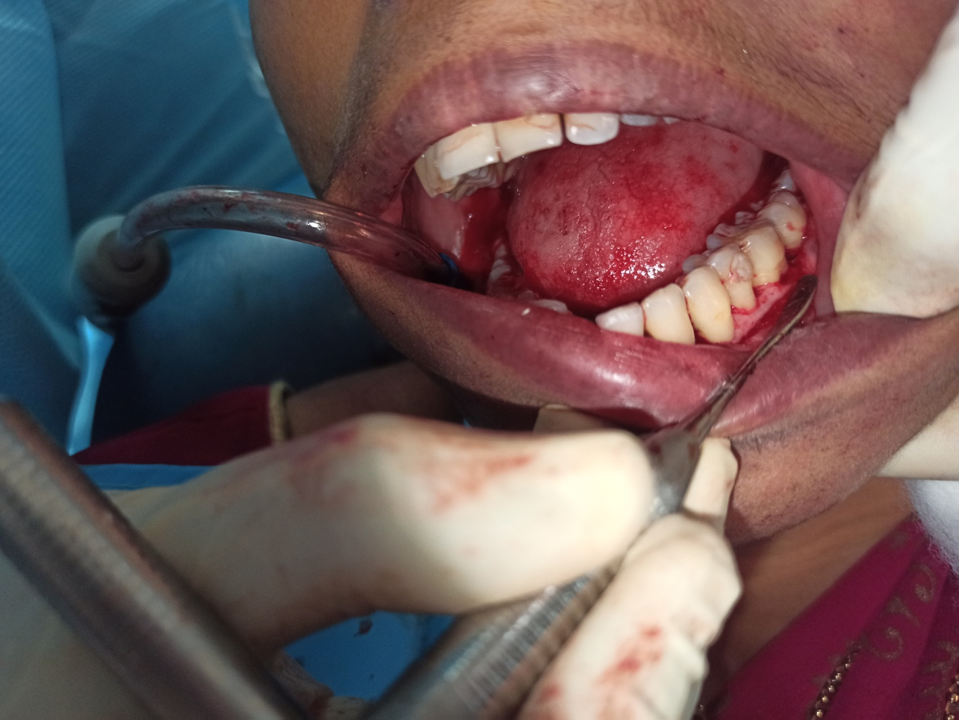
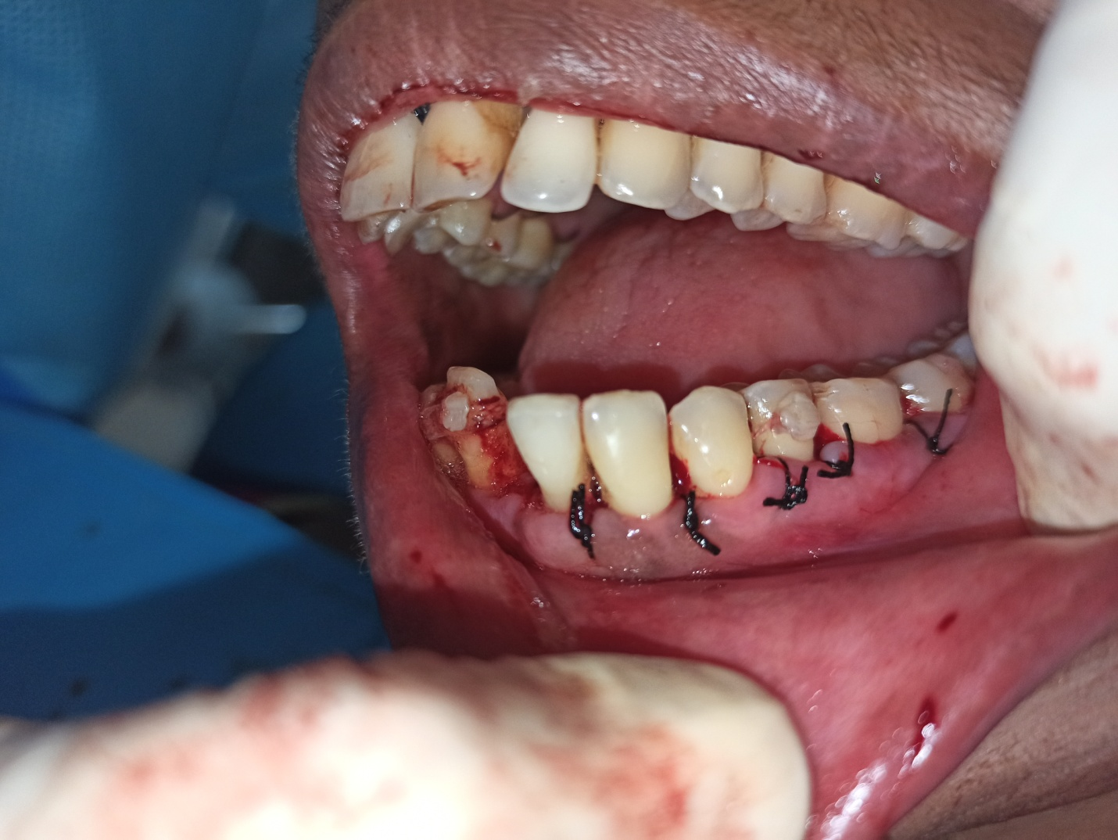
3RD QUADRANT

Slide 34
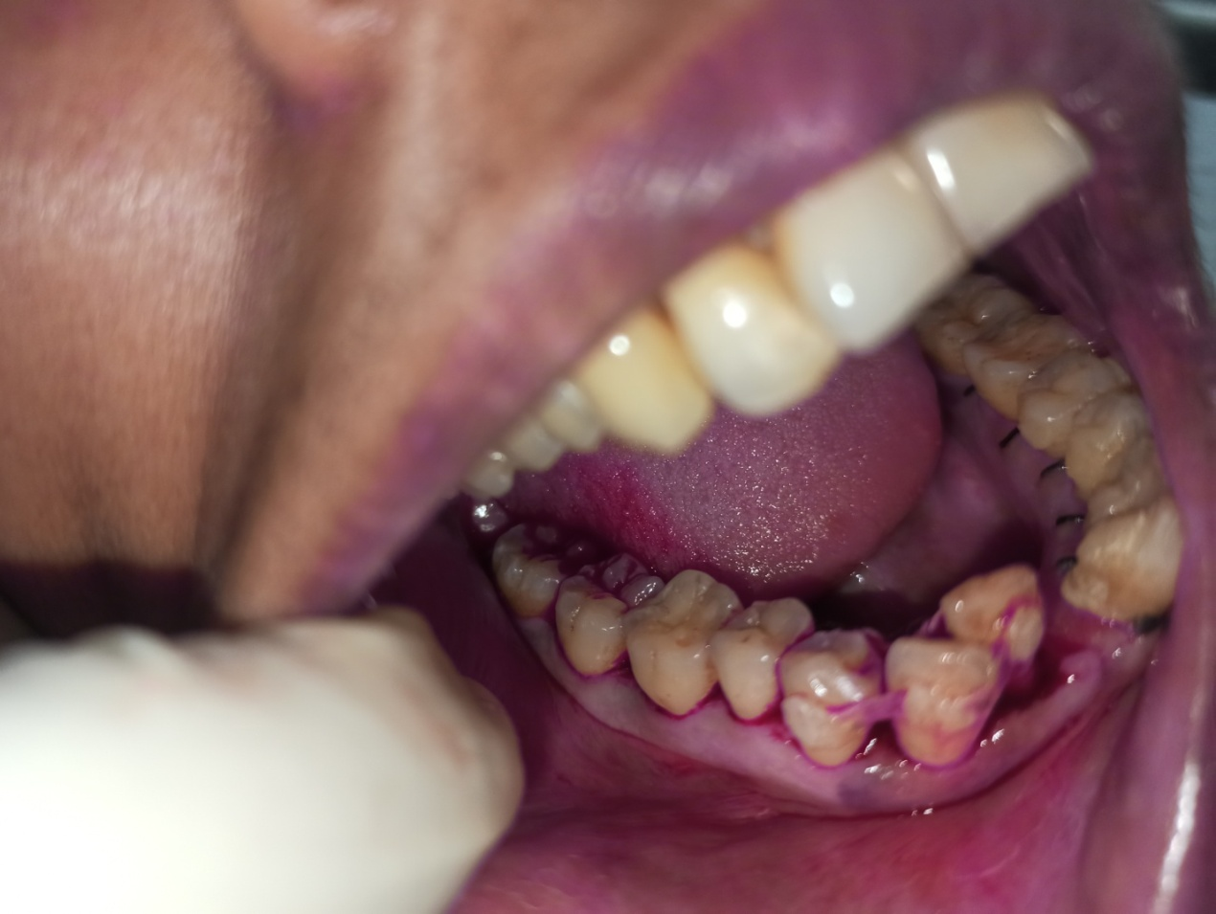
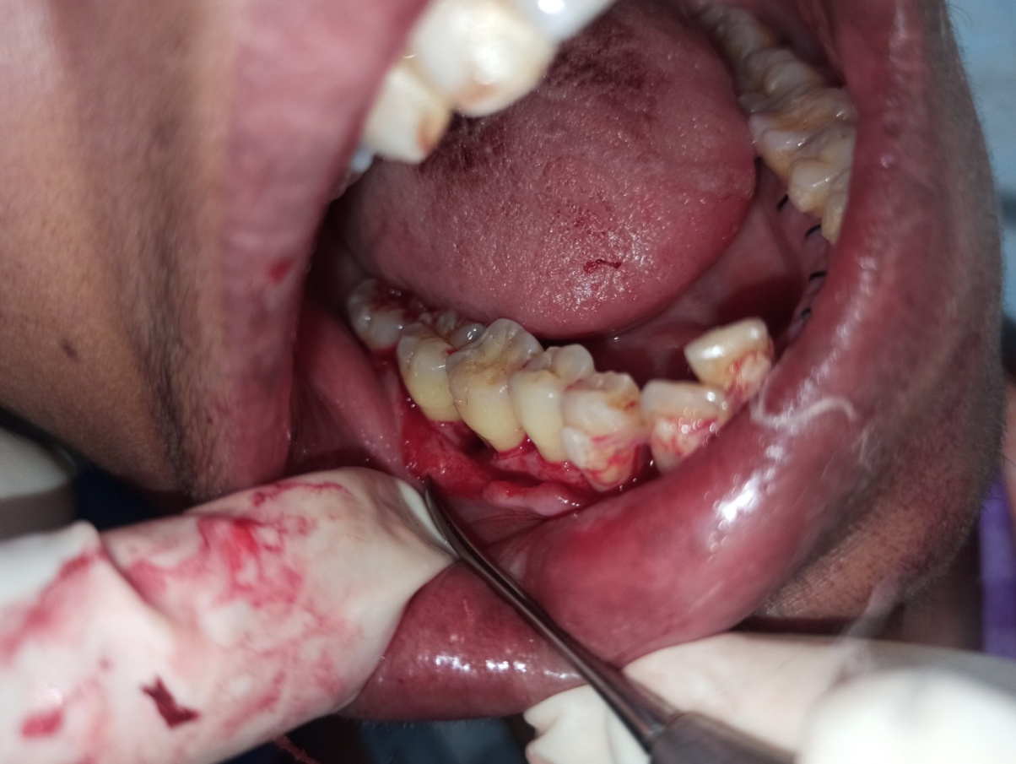
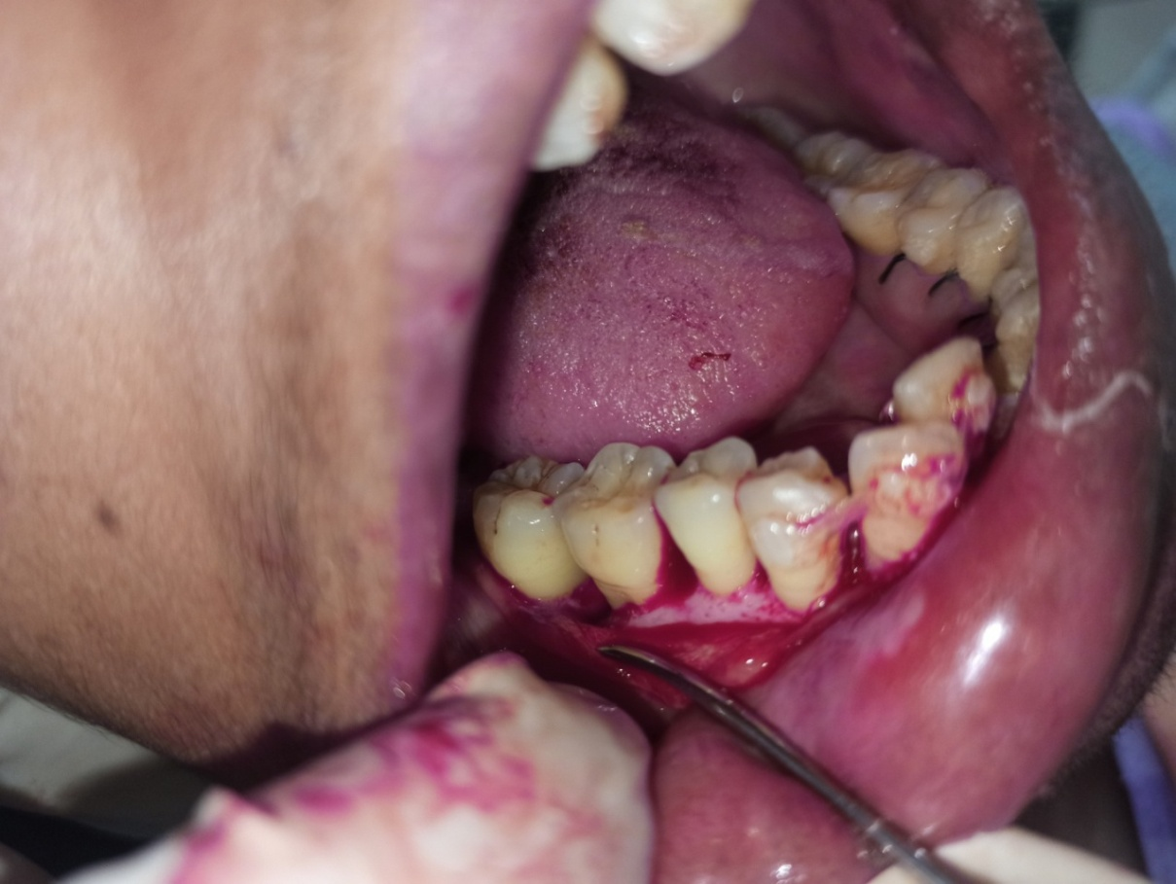
4TH QUADRANT

Slide 35
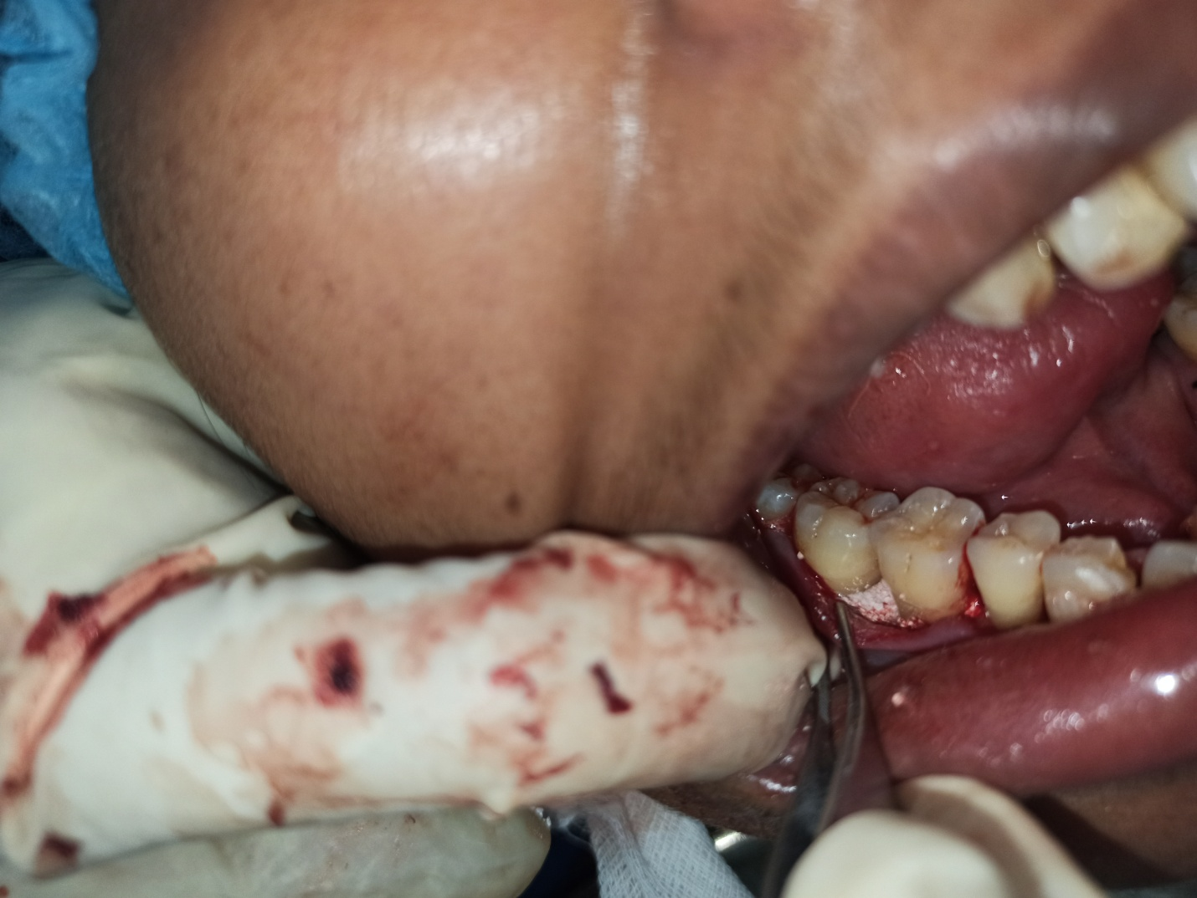
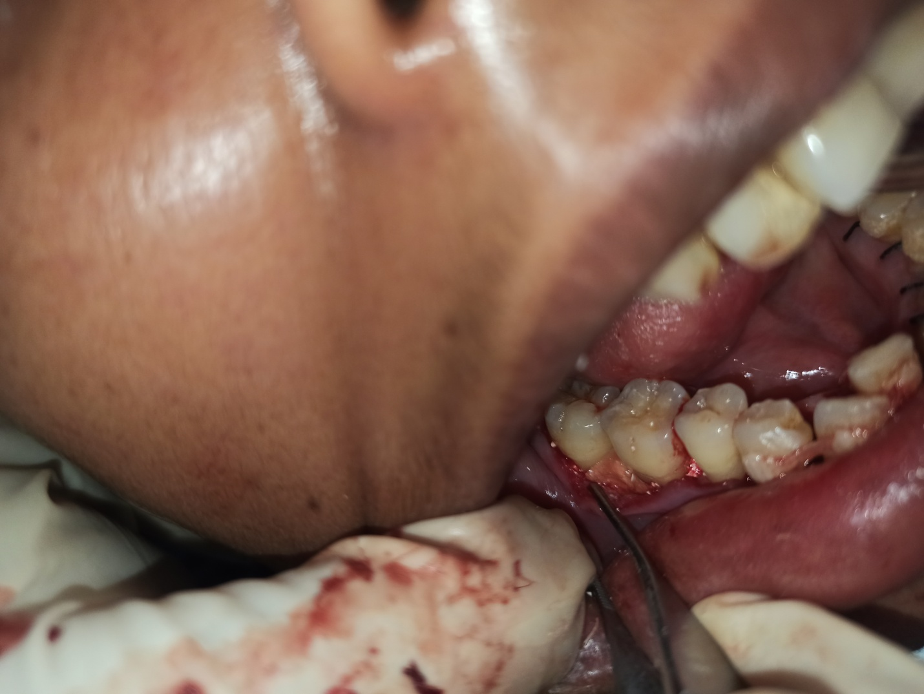
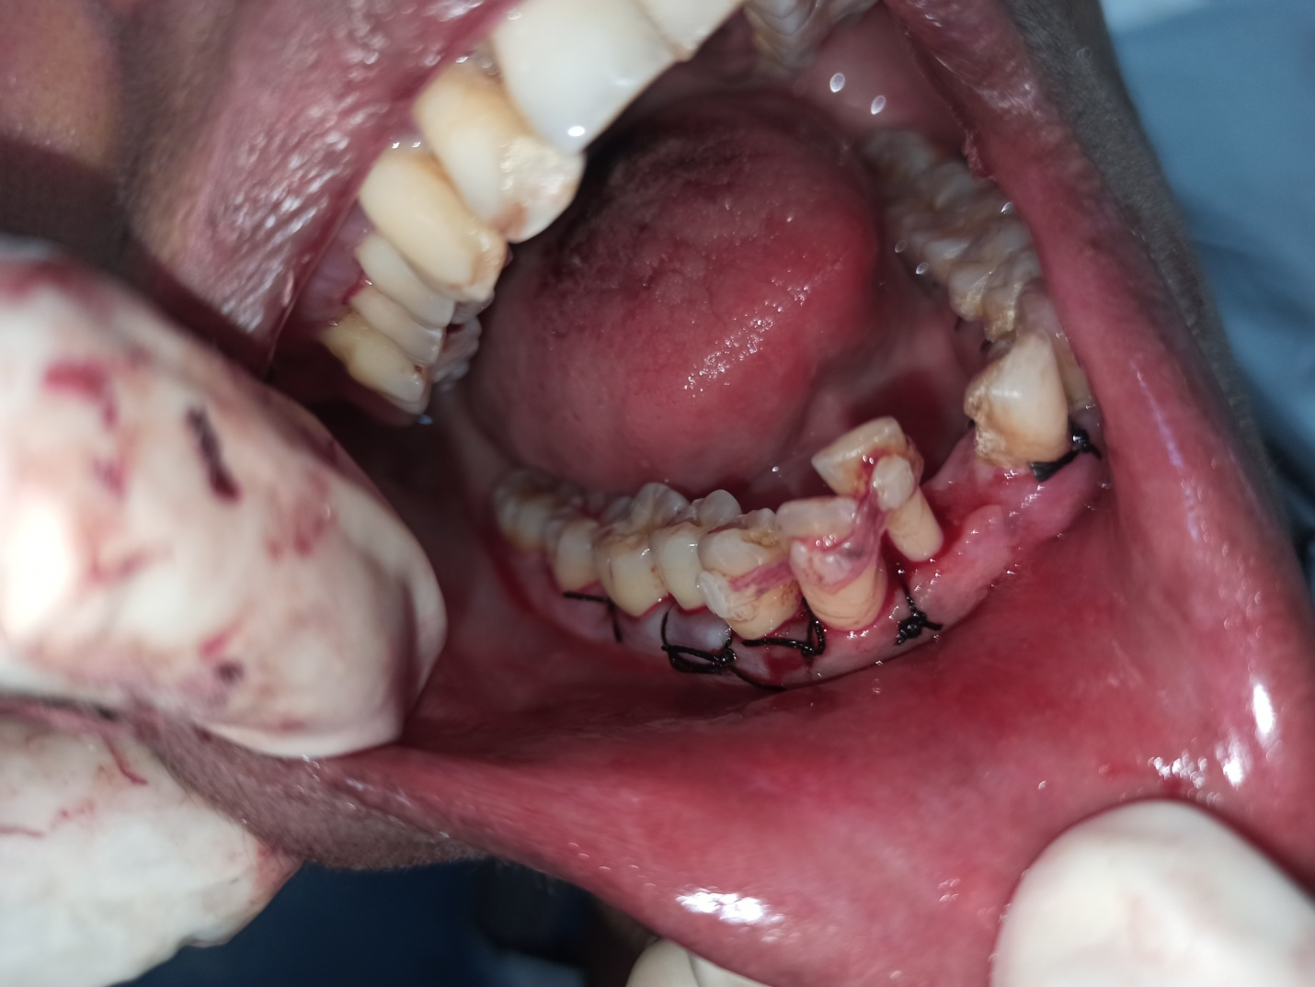

Slide 36
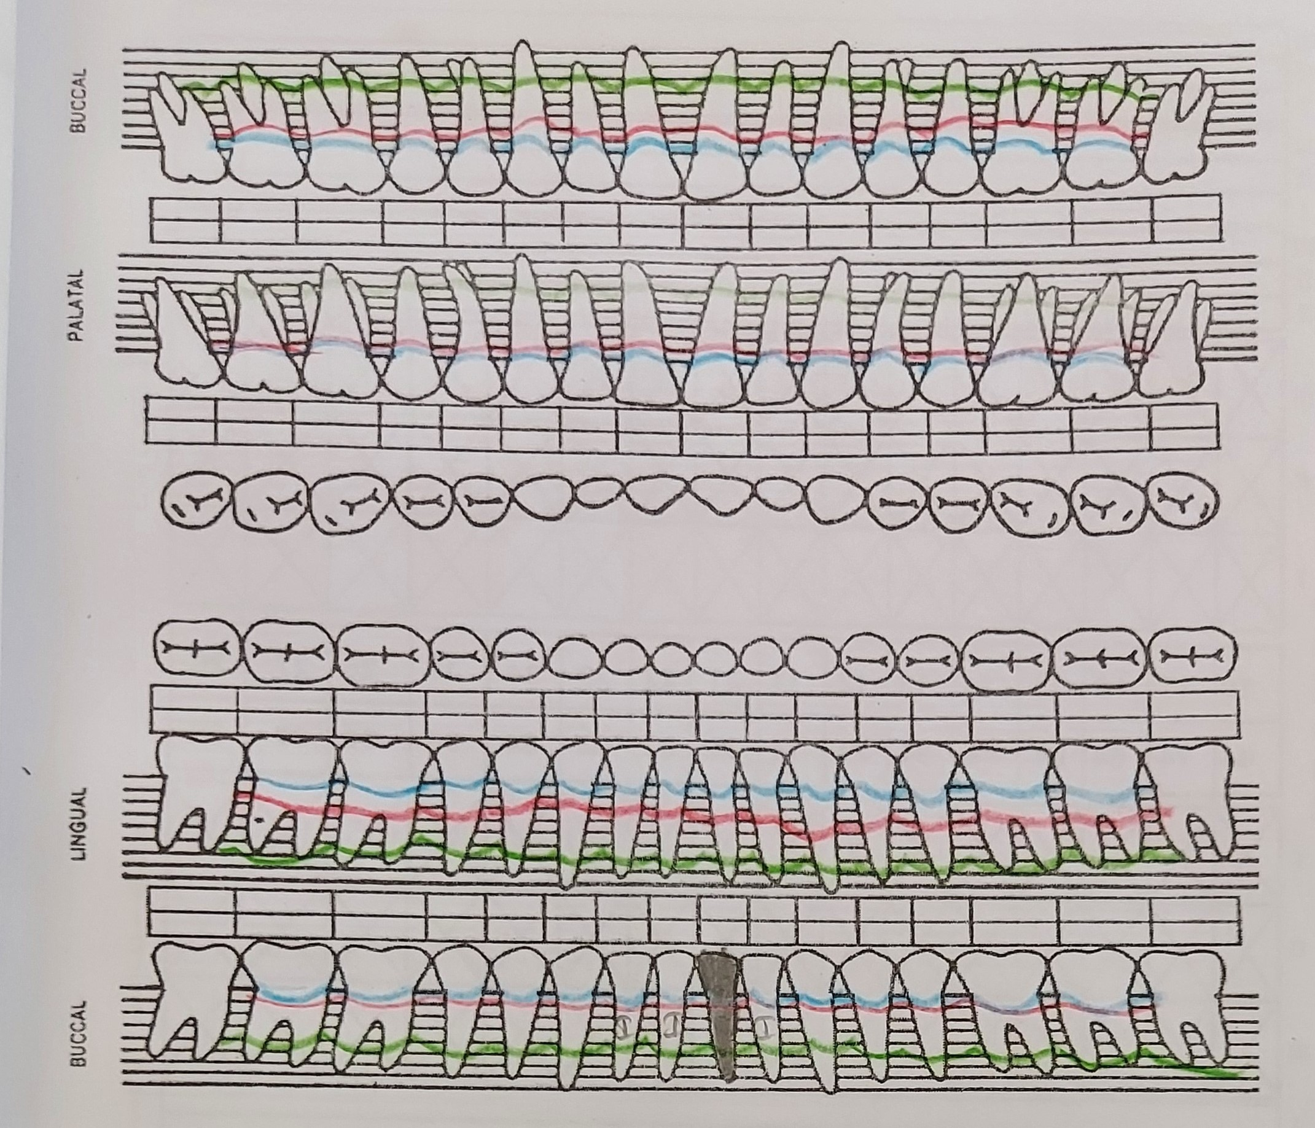
Post surgical charting

Slide 37
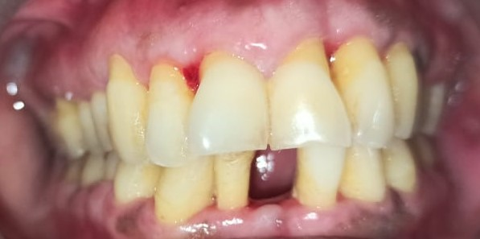
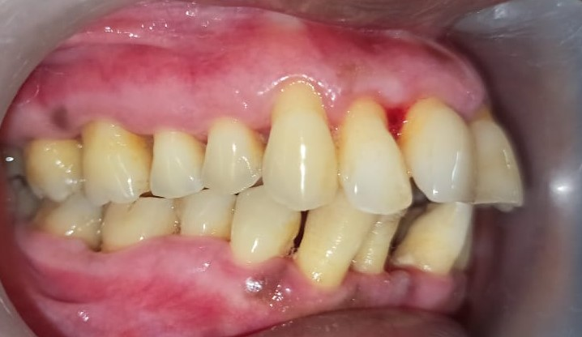
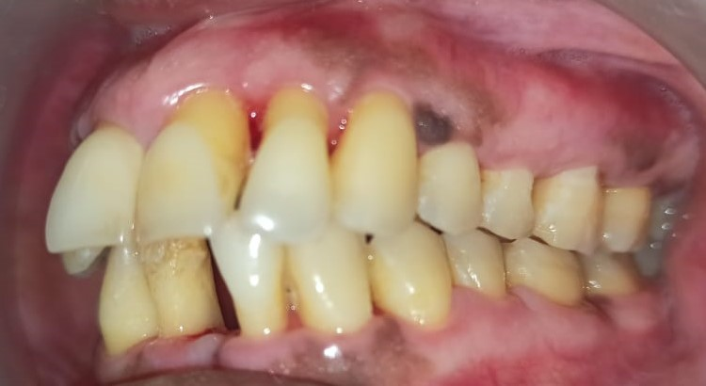
Post-operative

Slide 38
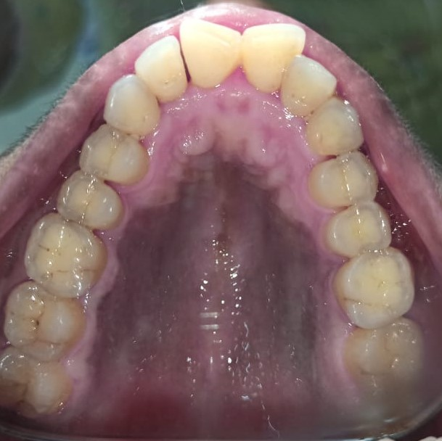
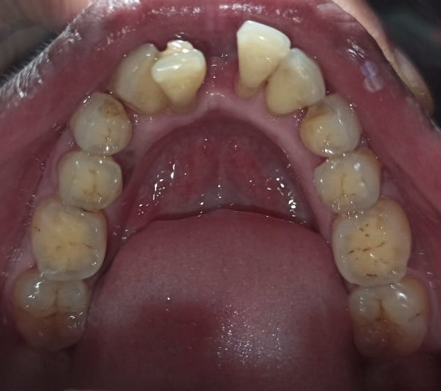

Slide 39
PRE OPERATIVE
AFTER 5 MONTHS

Slide 40
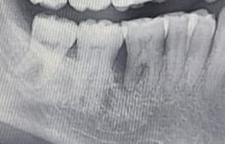
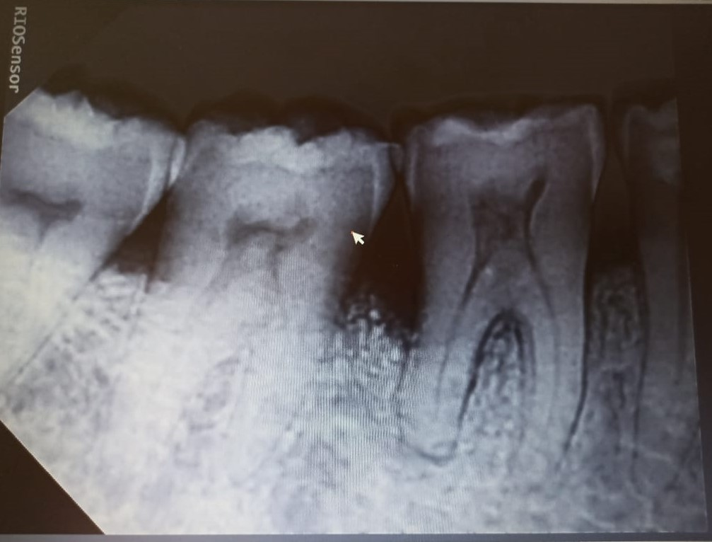
PRE OPERATIVE
AFTER 5 MONTHS

